Slide 1
Zephyrus Hand Motion-Controlled Remote Car
Design
Embedded Systems
Hugo Carvalho – A85156
José Mendes – A85951

Slide 2
Agenda
Problem Statement
System Overview
Hardware and Software Architectures
Hardware Specification
Peripheral Interface
Software Specification
Local System
Reinforcement Learning
Remote System
Test Cases
Local System
Remote System
Integration
Gantt Diagram

Slide 3
Problem Statement
Motion-tracking and gesture-controlled robots have been gaining traction in entertainment and medical applications.
In an R&D-like approach, the project will consist of a gesture-controlled car with a wristband as a remote controller.
The user will be able to accelerate and steer the vehicle using natural wrist and finger movements.

Slide 4
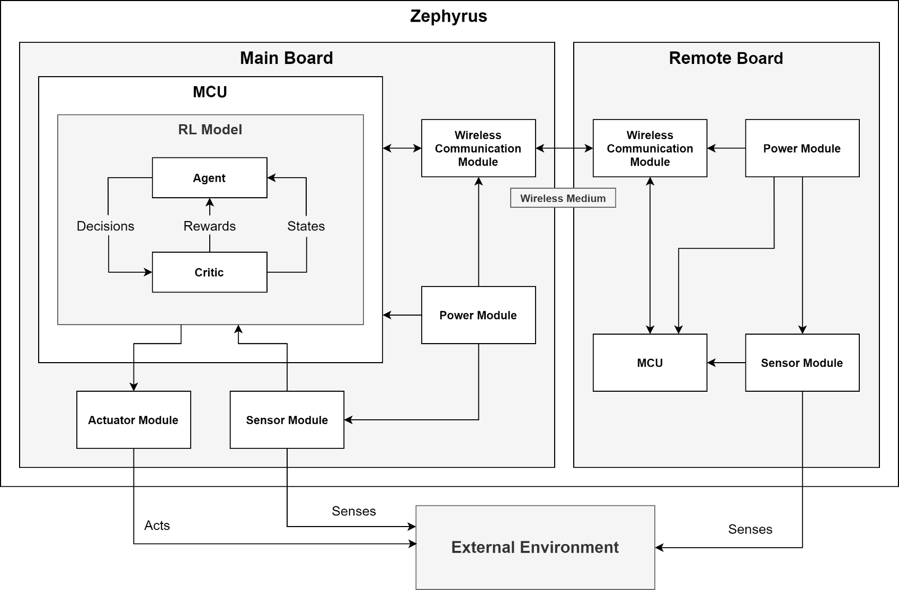
System Overview

Slide 5
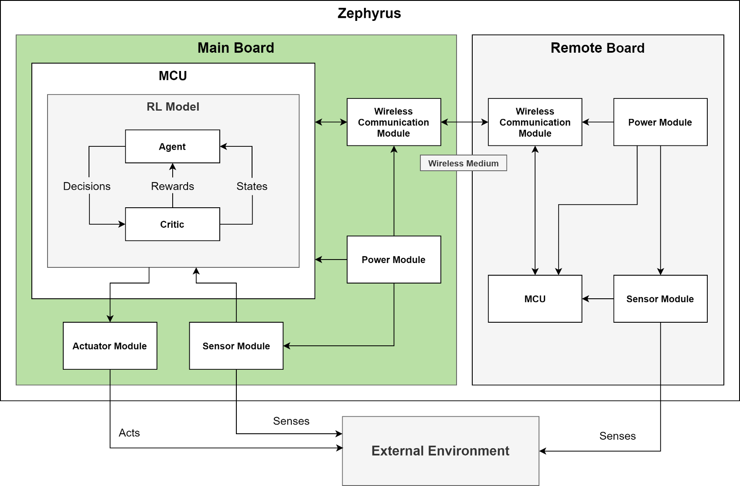
System Overview

Slide 6
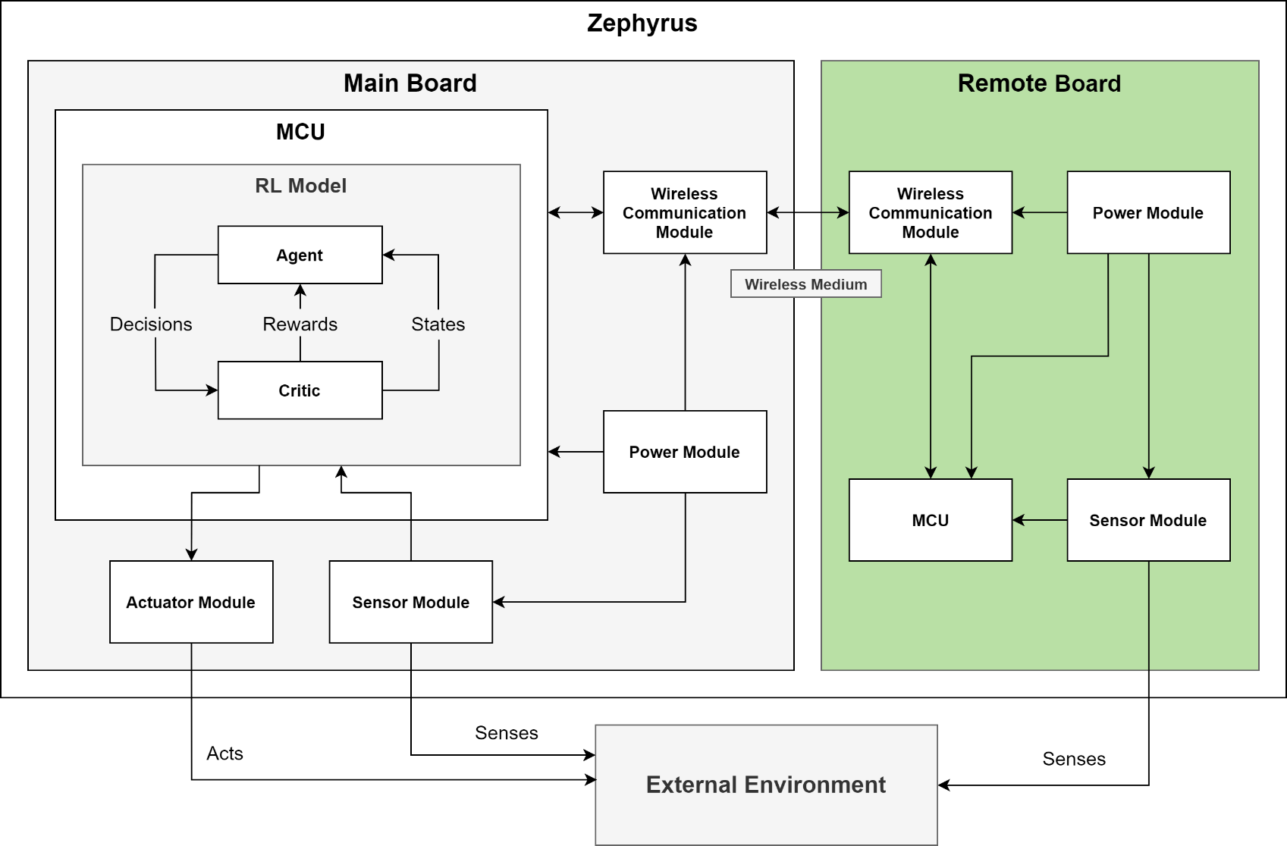
System Overview

Slide 7
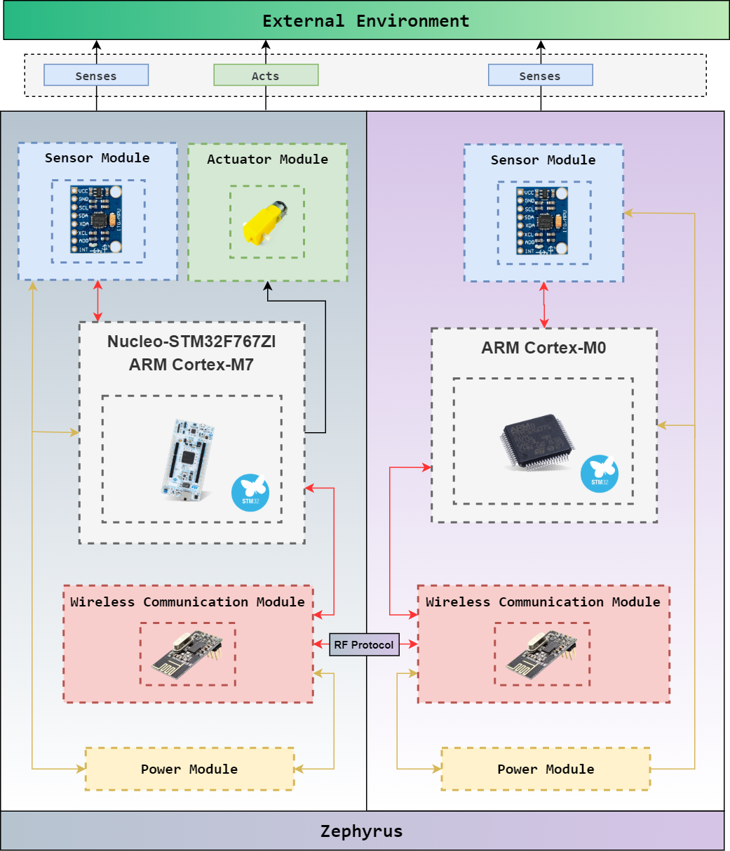
Hardware Architecture

Slide 8
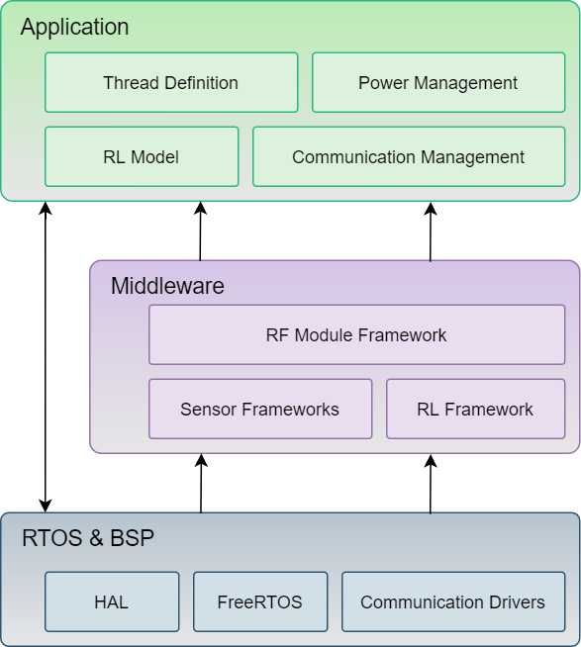
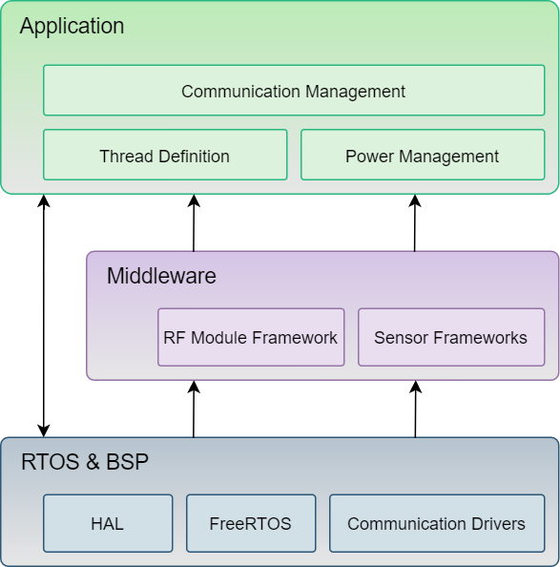
Software Architecture
Local System
Remote System

Slide 9
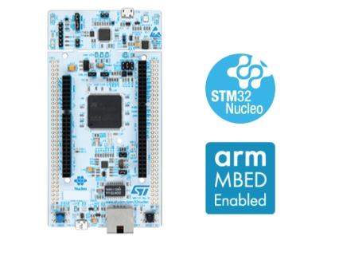
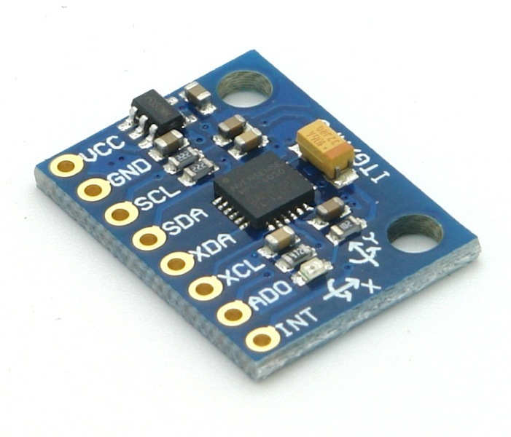
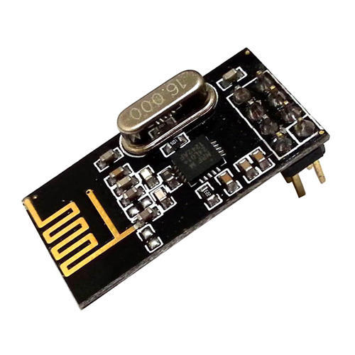
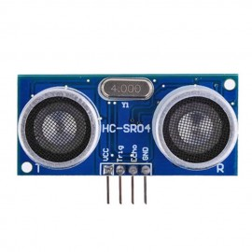
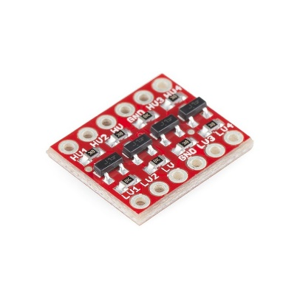
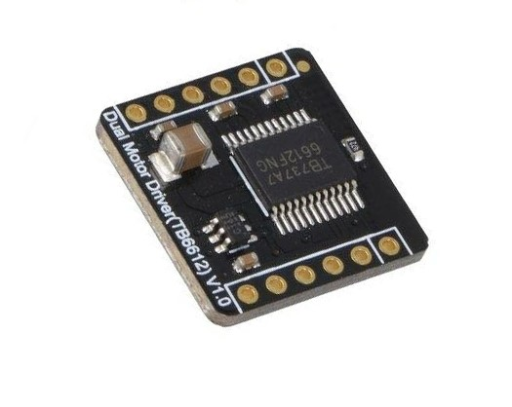
Hardware Specification: Local System
ST Microelectronics NUCLEO-F767ZI
MPU-6050 module
nRF24L01+ module
HC-SR04 board
Quad-BSS138 module
TB6612 module

Slide 10
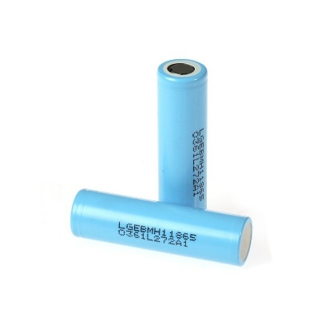
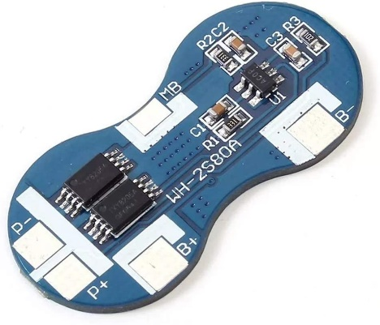
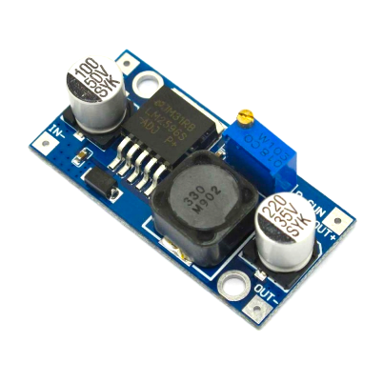
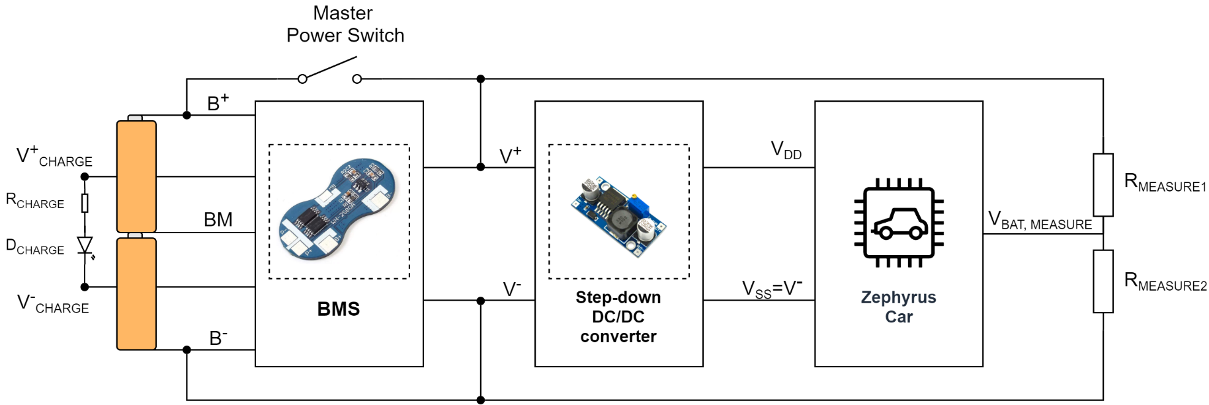
Hardware Specification: Local System
18650 batteries
WH-2s80 board
LM2596 module

Slide 11
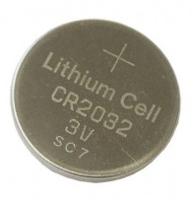
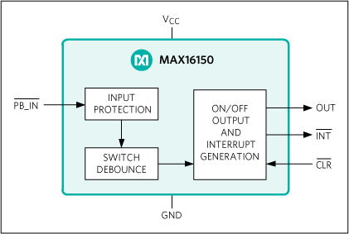
Hardware Specification: Remote System
MPU-6050 module
nRF24L01+ module
CR2032 cell
MAX16150 push button ON/OFF controller IC

Slide 12
Hardware Specification: Custom Hardware (Prototype Alpha)
STM32F0 Development Board

Slide 13
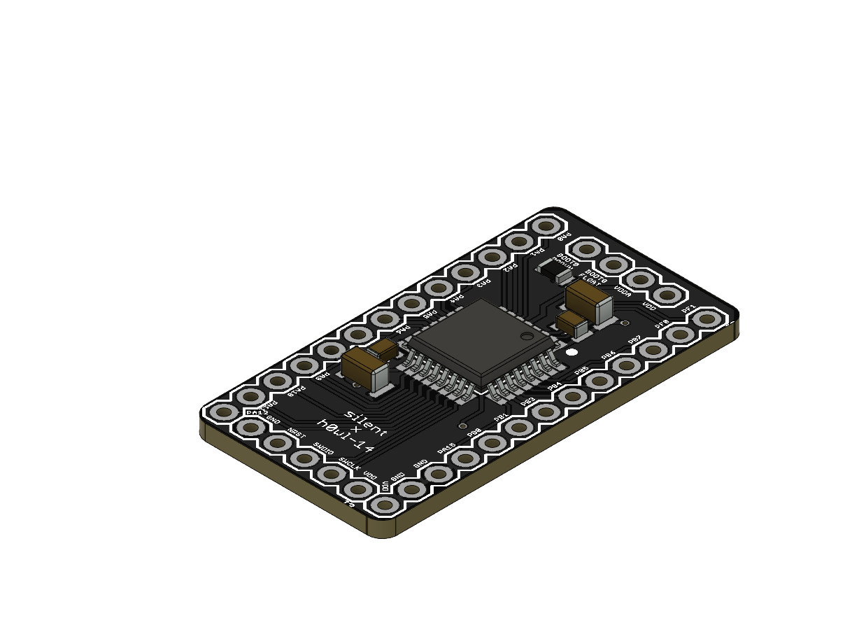
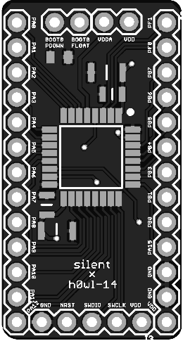
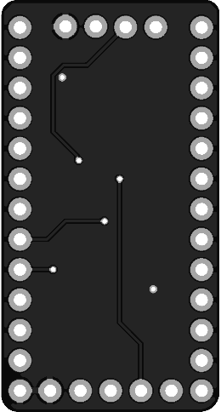
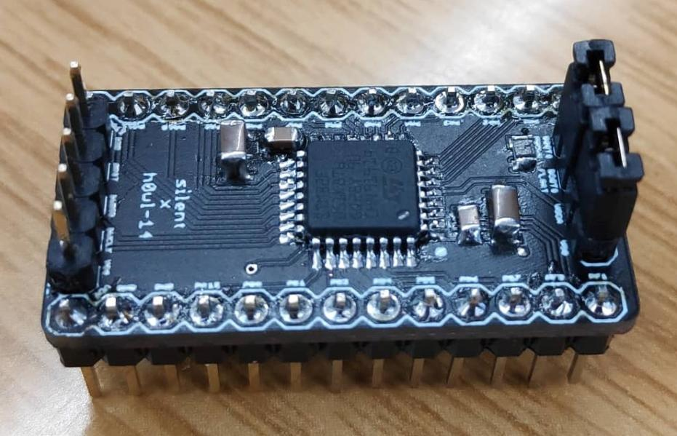
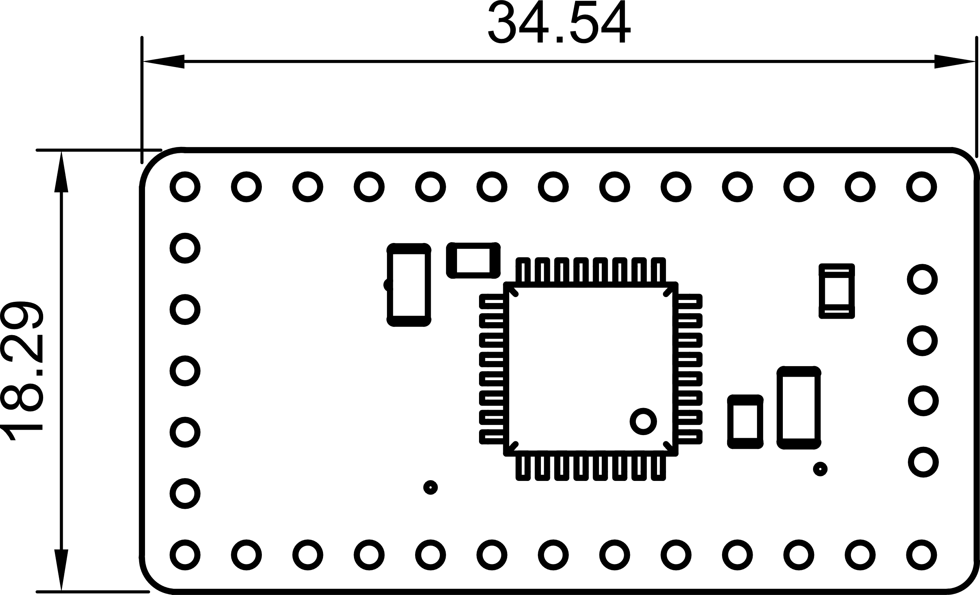
Hardware Specification: Custom Hardware (Prototype Alpha)
2D Board View
3D Board View
Physical Board
Dimensions (millimeters)

Slide 14
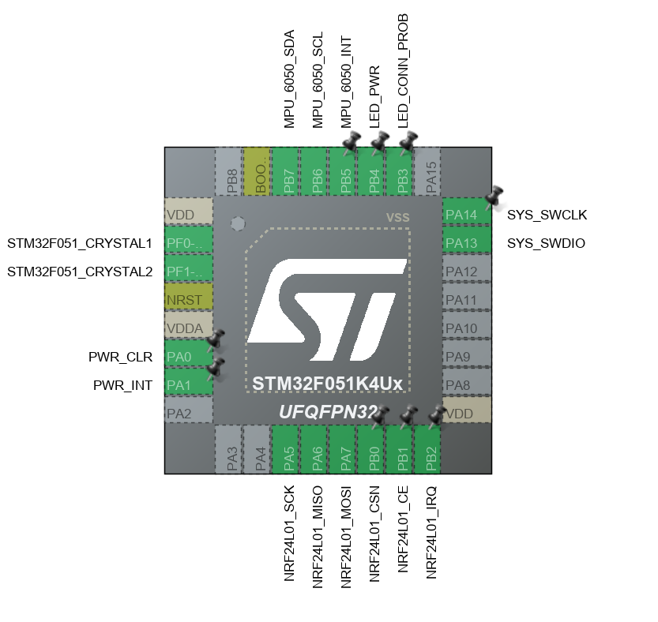
Hardware Specification: Custom Hardware (Prototype Beta)

Slide 15
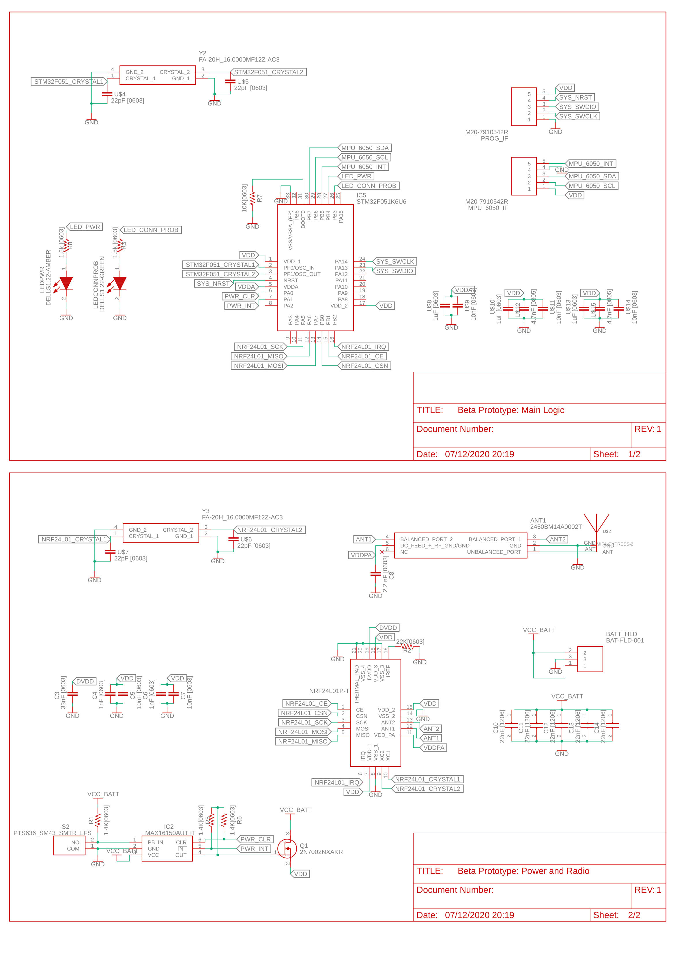
Hardware Specification: Custom Hardware (Prototype Beta)

Slide 16
Hardware Specification: Custom Hardware (Prototype Beta)

Slide 17
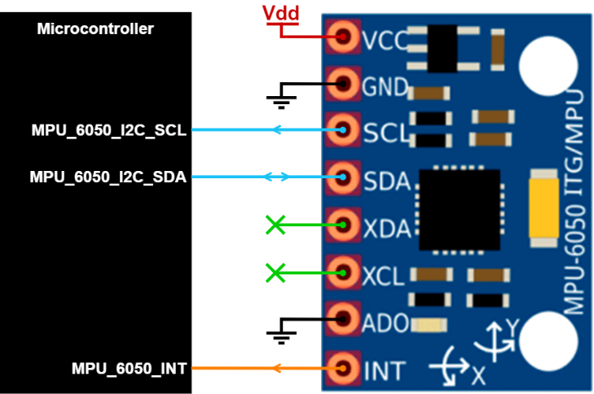
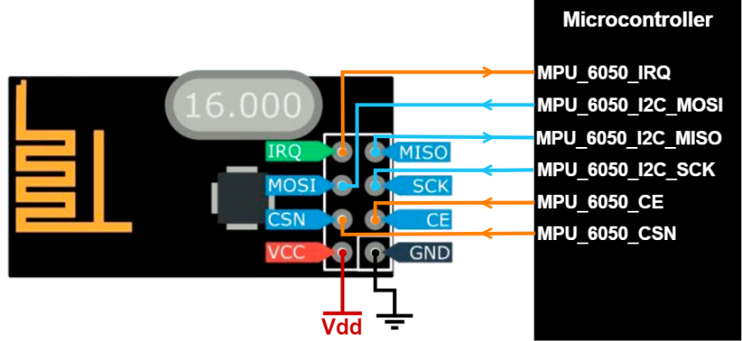
Peripheral Interface
MPU-6050 module
(Local/Remote)
nRF24L01+ module
(Local/Remote)

Slide 18
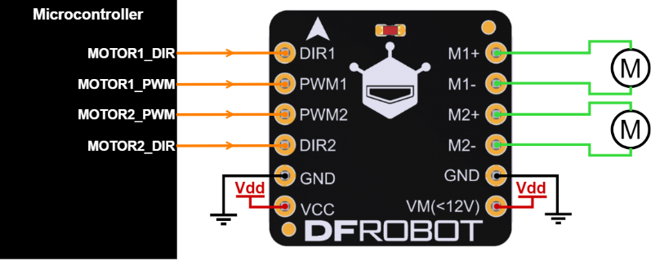
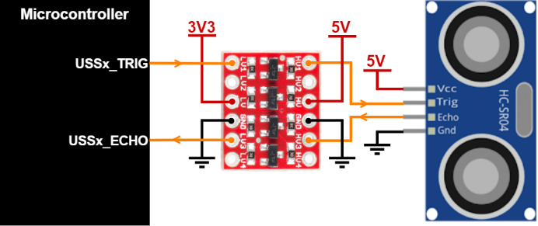
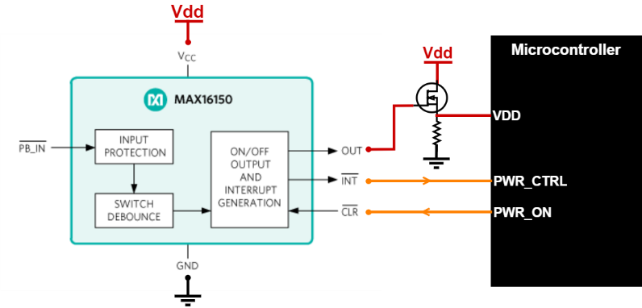
Peripheral Interface
TB6612 module interface
(Local)
Quad-BSS138 module interface
(Local)
MAX16150 interface
(Remote)

Slide 19
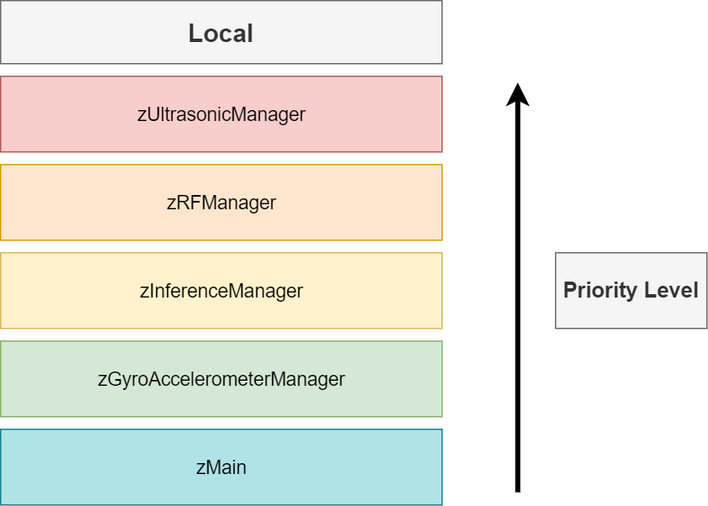
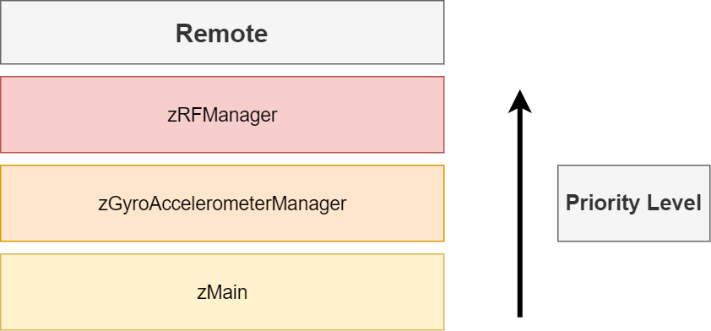
Software Specification: Task Priority

Slide 20
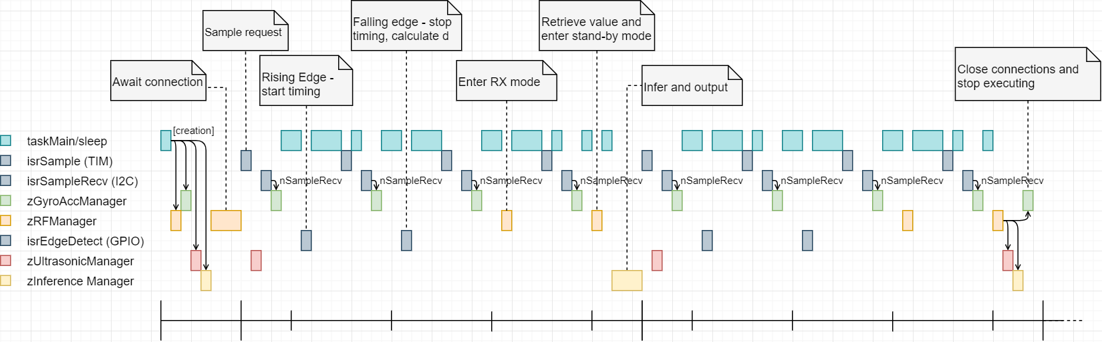
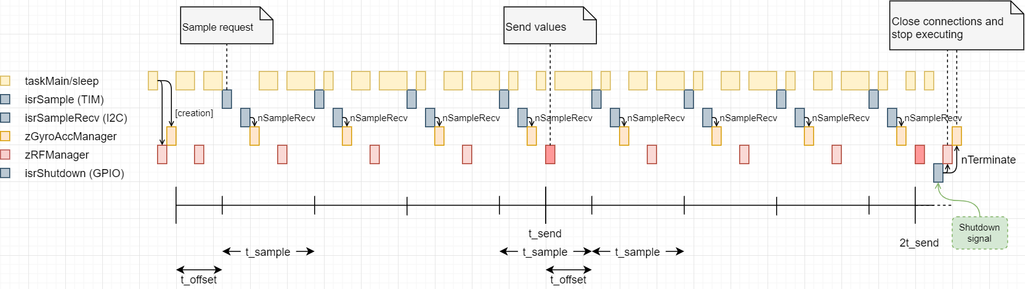
Software Specification: Task Timelines
Local System
Remote System

Slide 21
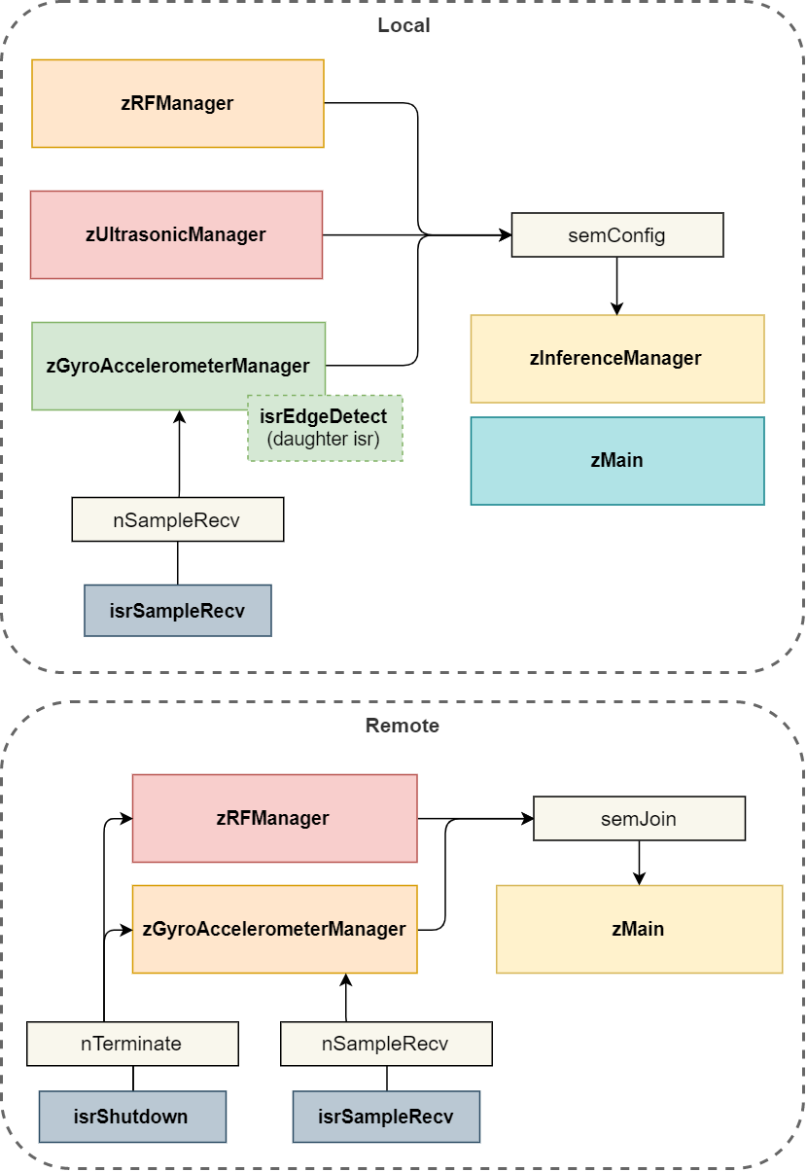
Software Specification: Task Communication

Slide 22
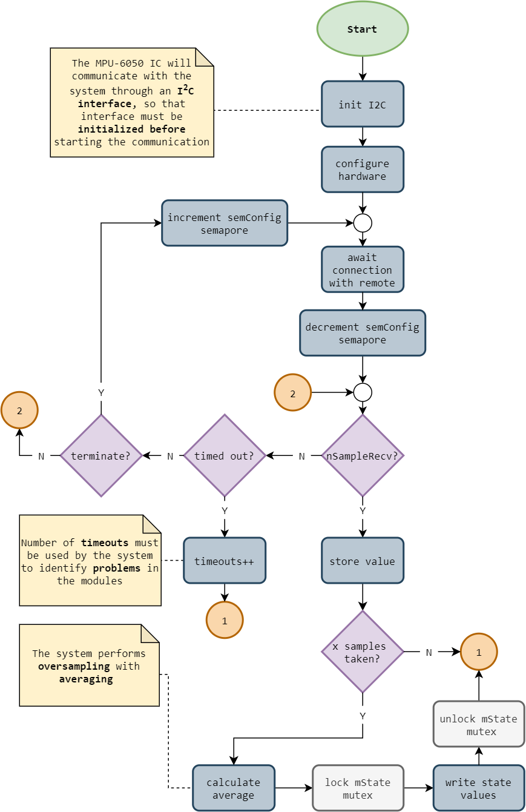
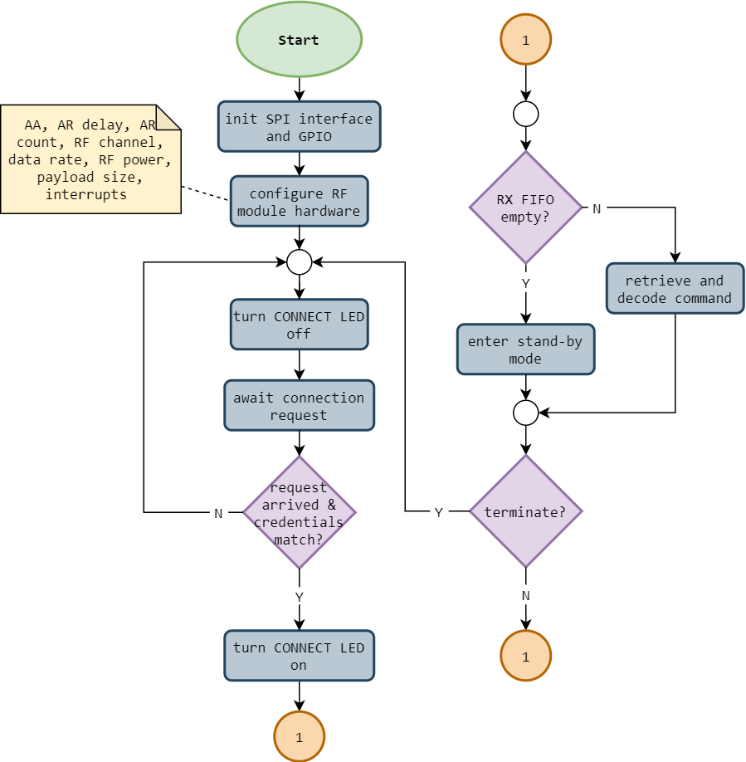
Software Specification: Local System Threads
zGyroAccelerometerManager
zRFManager

Slide 23
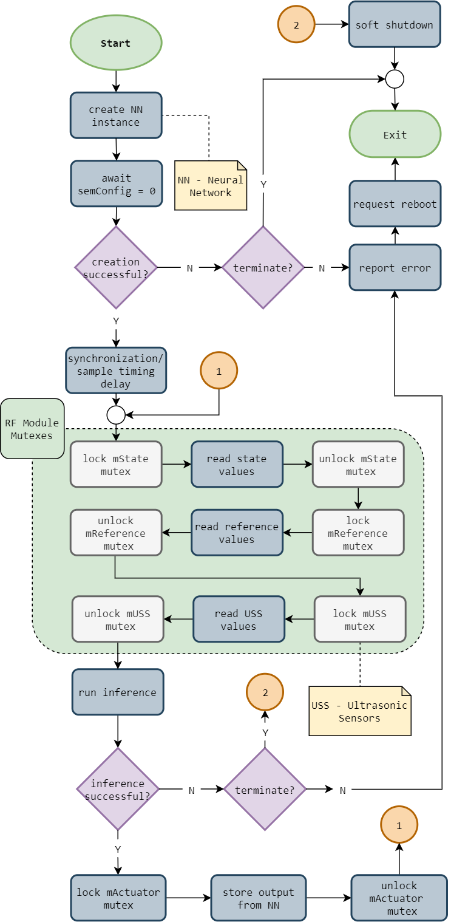
Software Specification: Local System Threads
zInferenceManager

Slide 24
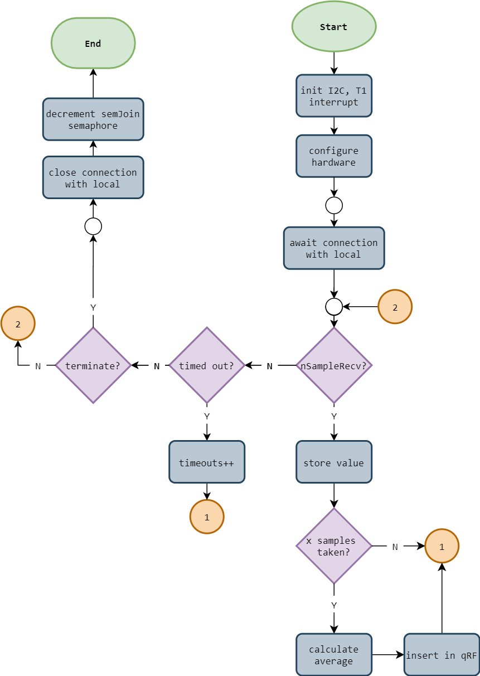
Software Specification: Remote System Threads
zGyroAccelerometerManager

Slide 25
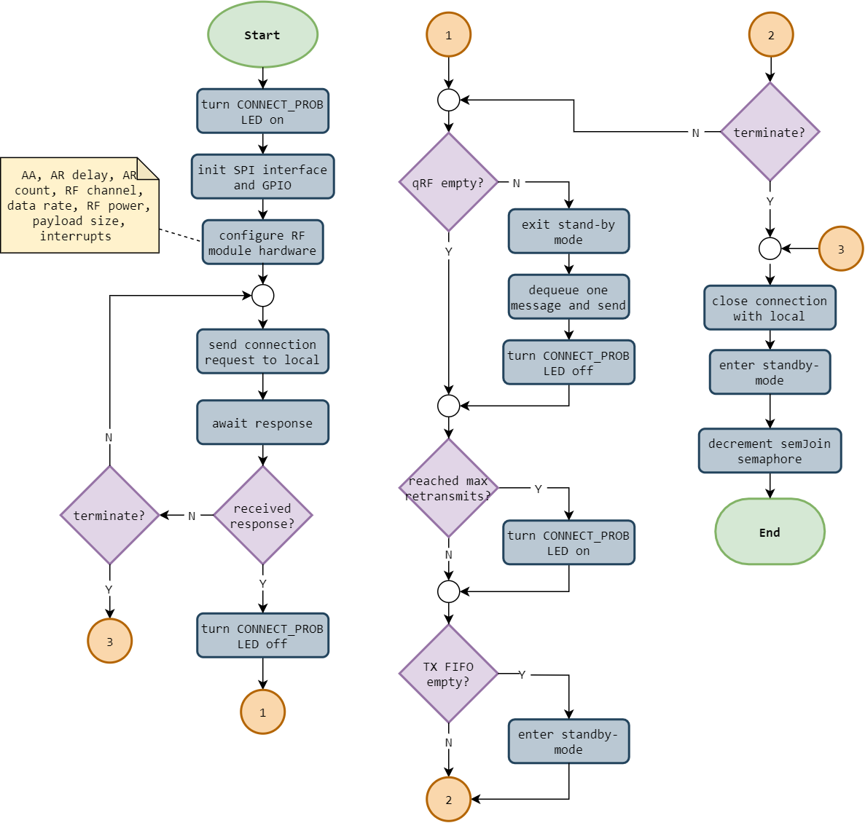
Software Specification: Remote System Threads
zRFManager

Slide 26
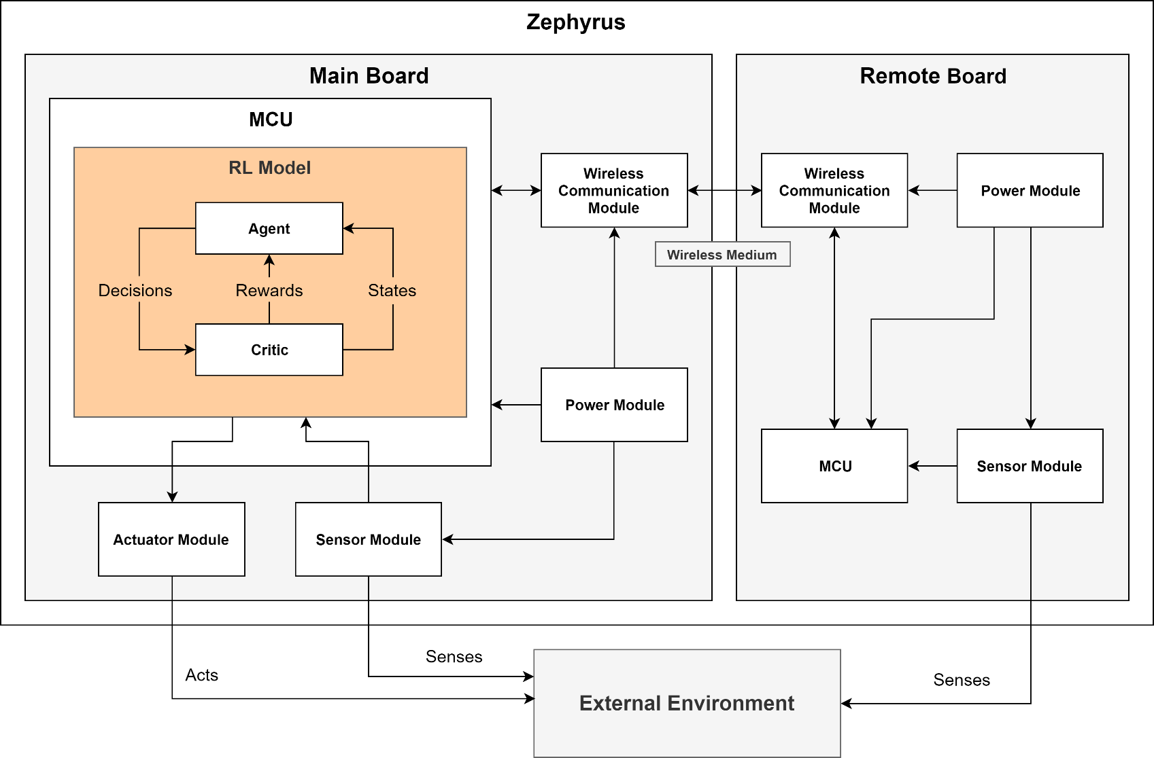
Reinforcement Learning
System Overview

Slide 27
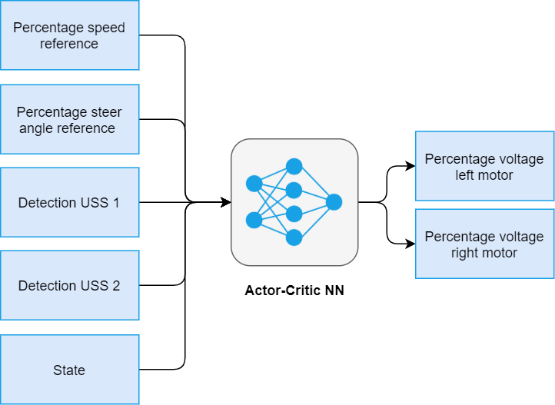
Software Specification: Reinforcement Learning
Neural Network’s Input-Output diagram

Slide 28
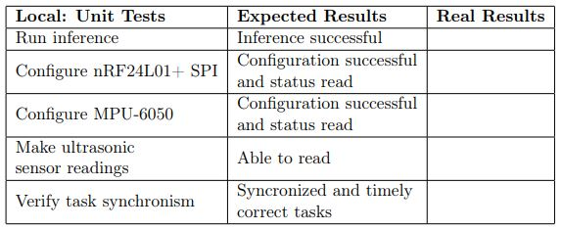
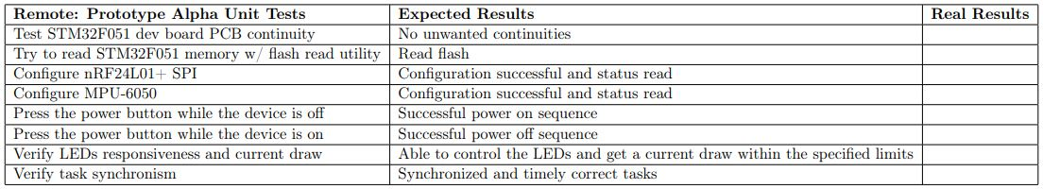
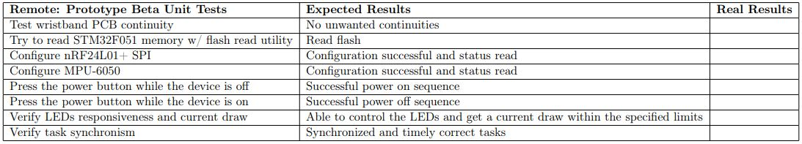
Test Cases: Unit Tests

Slide 29
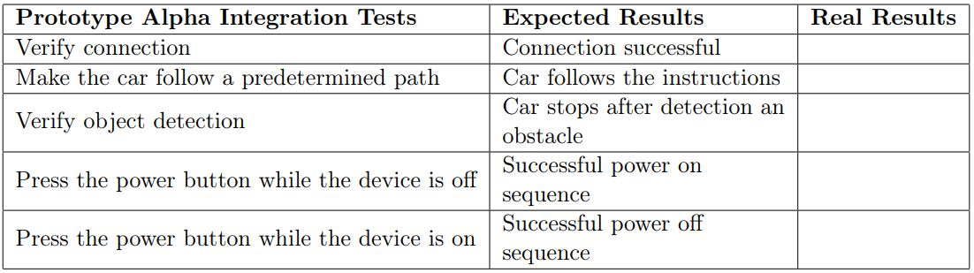
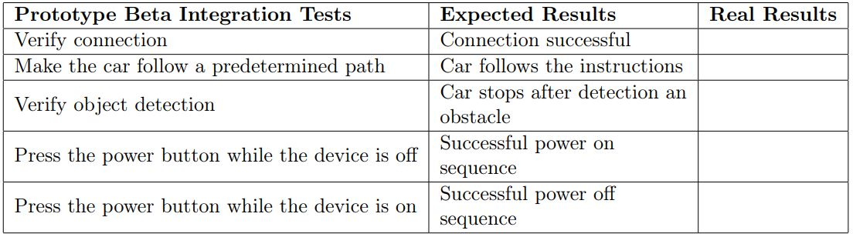
Test Cases: Integration Tests

Slide 30
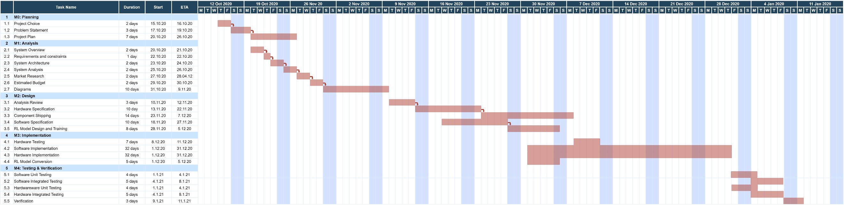
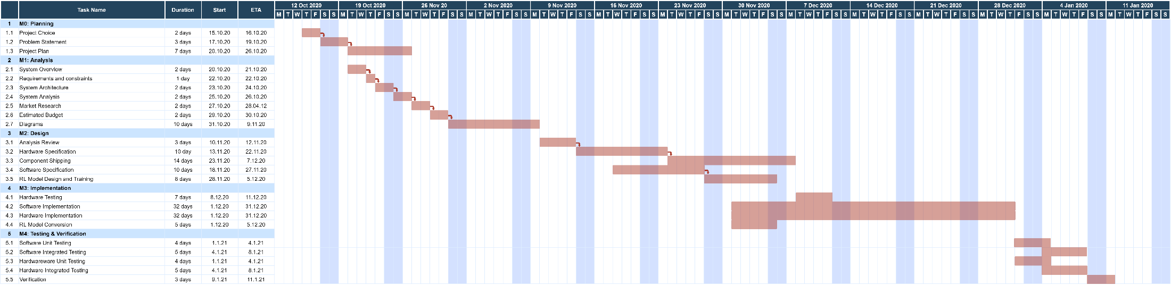
Gant Diagram

